Slide 1

MECHANICAL ENGINEERING SCIENCE (UE24ME141A)
Srinivasa Prasad K S
Department of Mechanical Engineering

Slide 2
MECHANICAL ENGINEERING SCIENCE
Unit1
Srinivasa Prasad K S
Department of Mechanical Engineering

Slide 3
MECHANICAL ENGINEERING SCIENCE
Chapter 1 – Basic Principles of Thermodynamics and Fluid Energy
Srinivasa Prasad K S
Department of Mechanical Engineering
Courtesy: Dr. V Krishna, Department of Mechanical Engineering

Slide 4
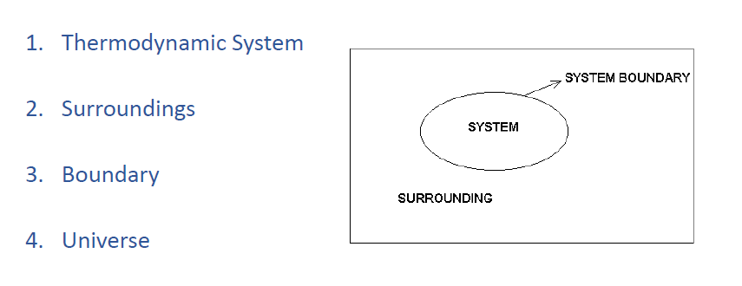
MECHANICAL ENGINEERING SCIENCE
System, Boundary and Surroundings

Slide 5
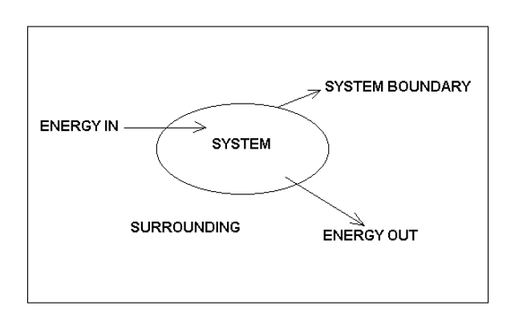
MECHANICAL ENGINEERING SCIENCE
Closed System

Slide 6
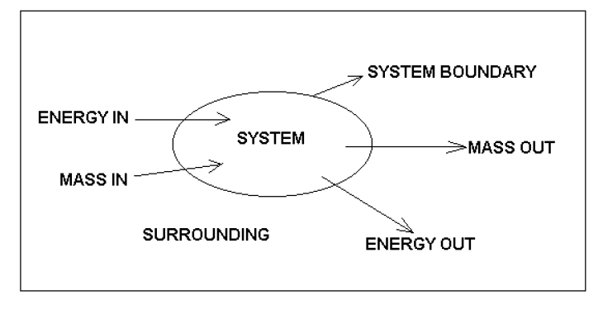
MECHANICAL ENGINEERING SCIENCE
Open System

Slide 7
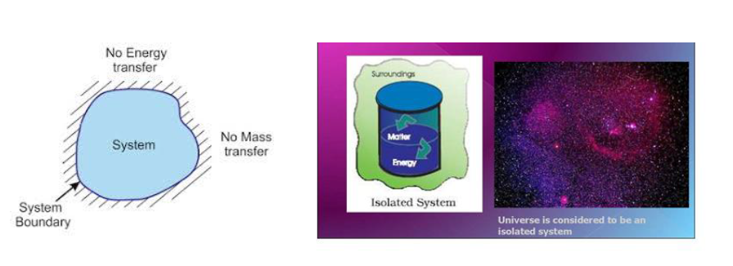
MECHANICAL ENGINEERING SCIENCE
Isolated System

Slide 8
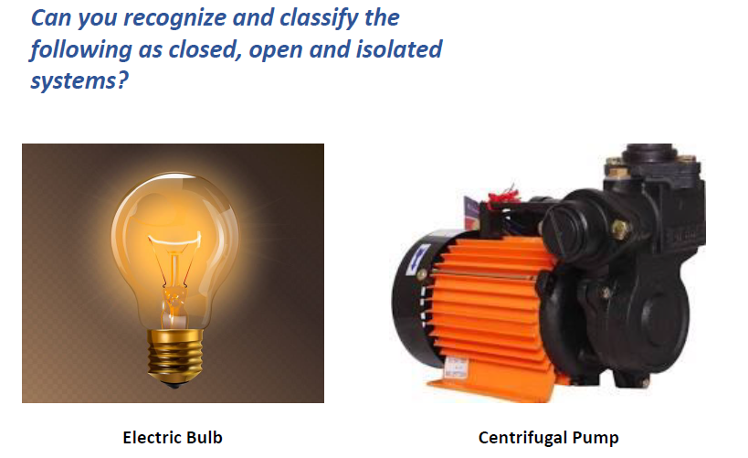
MECHANICAL ENGINEERING SCIENCE

Slide 9
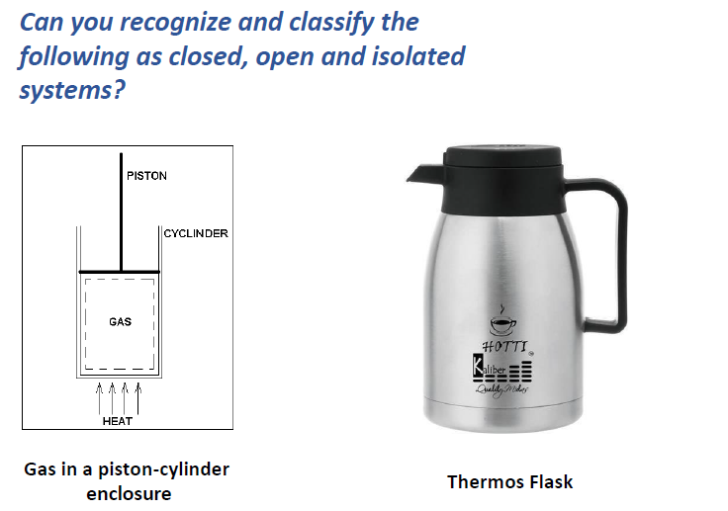
MECHANICAL ENGINEERING SCIENCE

Slide 10
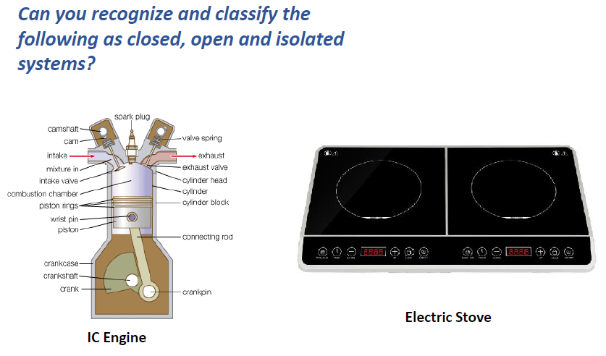
MECHANICAL ENGINEERING SCIENCE

Slide 11
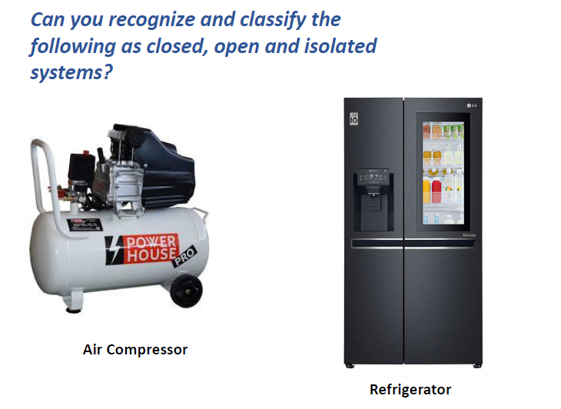
MECHANICAL ENGINEERING SCIENCE

Slide 12
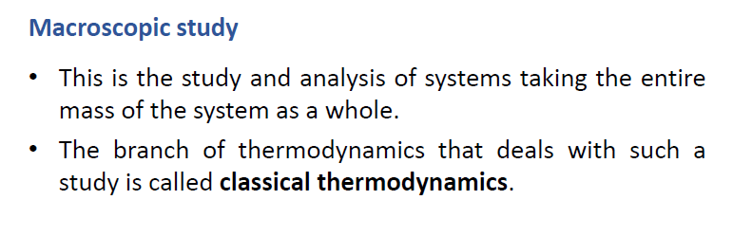
MECHANICAL ENGINEERING SCIENCE
Macroscopic and Microscopic Study

Slide 13
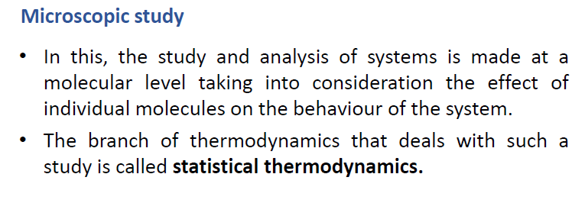
MECHANICAL ENGINEERING SCIENCE
Macroscopic and Microscopic Study

Slide 14
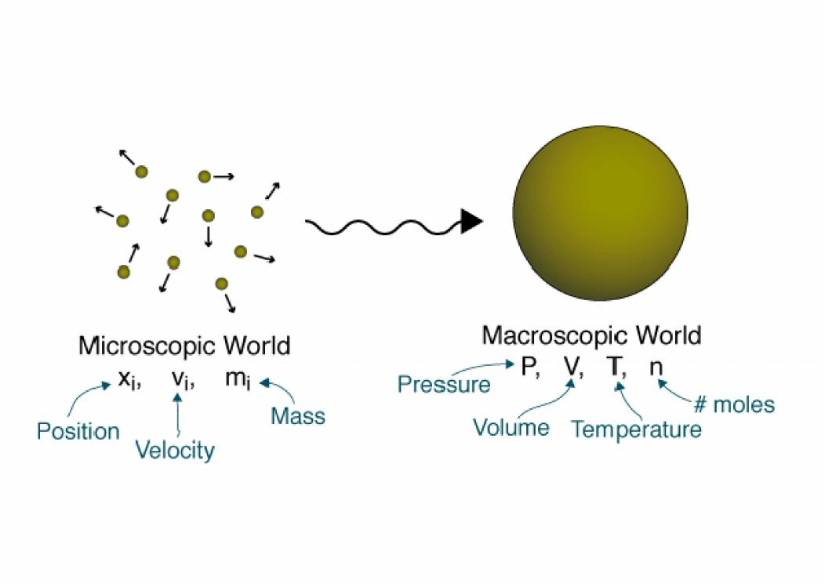
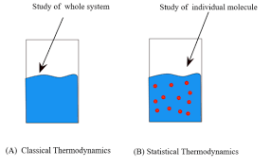
MECHANICAL ENGINEERING SCIENCE
Macroscopic and Microscopic Study

Slide 15
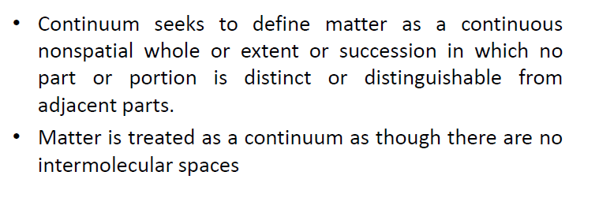
MECHANICAL ENGINEERING SCIENCE
Concept of continuum
Any material, solid, liquid or gas is composed of billions of individual molecules, in a very small region, separated by empty spaces in between them. The continuum assumption considers that matter is continuously distributed and fills the entire region of the space it occupies.

Slide 16
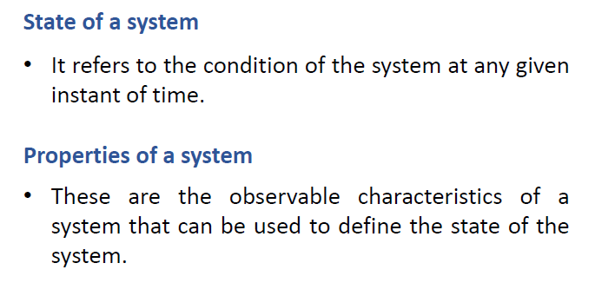
MECHANICAL ENGINEERING SCIENCE
State and Properties of a system

Slide 17
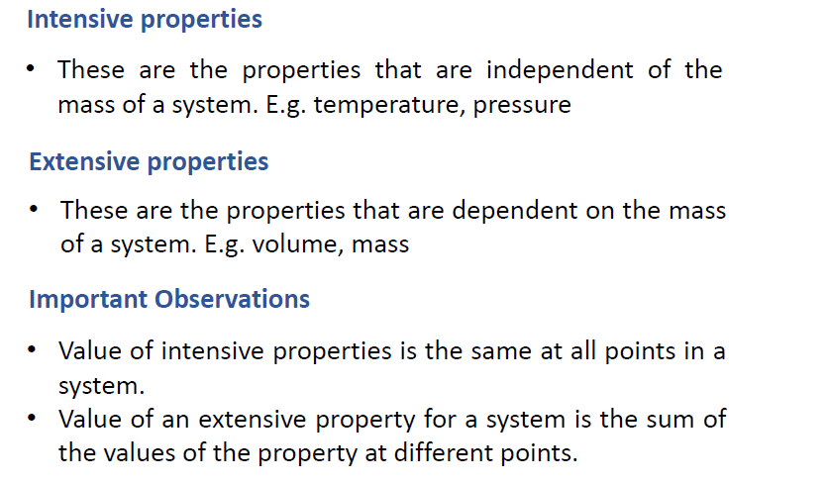
MECHANICAL ENGINEERING SCIENCE
Intensive and Extensive Properties

Slide 18
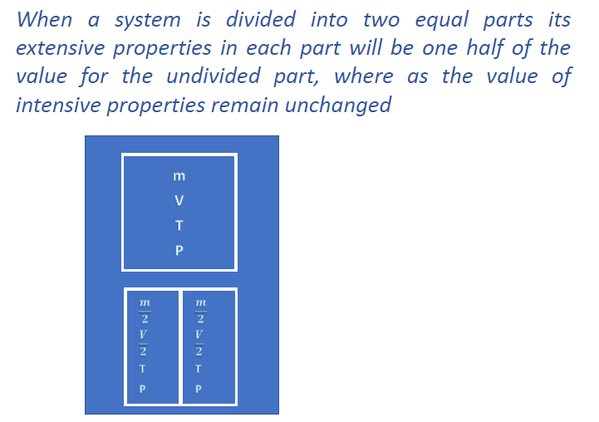
MECHANICAL ENGINEERING SCIENCE
Intensive and Extensive Properties

Slide 19
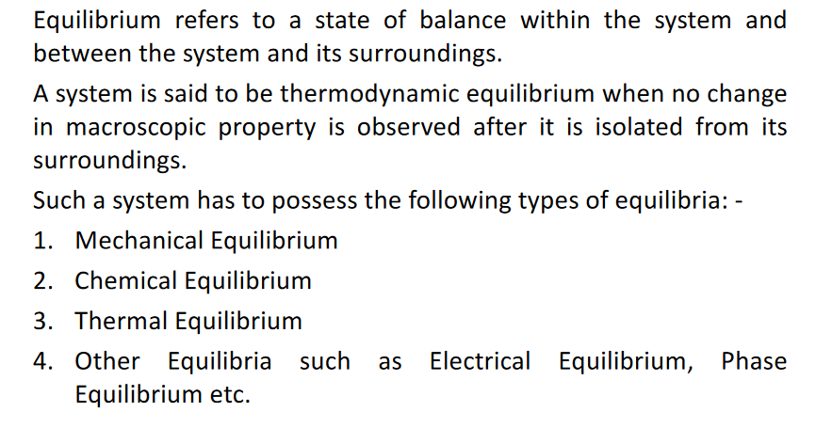
MECHANICAL ENGINEERING SCIENCE
Thermodynamic Equilibrium

Slide 20
MECHANICAL ENGINEERING SCIENCE
Thermodynamic Equilibrium
Thermodynamic equilibrium is a state where a system's properties don't change over time, unless an external force is applied.
Gas in a cylinder with a movable piston: When the temperature and pressure inside the cylinder are in equilibrium, the gas is in thermodynamic equilibrium.
Hot food
When hot food is left out, it exchanges heat with the air until both are at the same temperature.
3. Cup of hot tea
When a cup of hot tea is left out, the temperature of the tea eventually matches the temperature of the surrounding air.

Slide 21
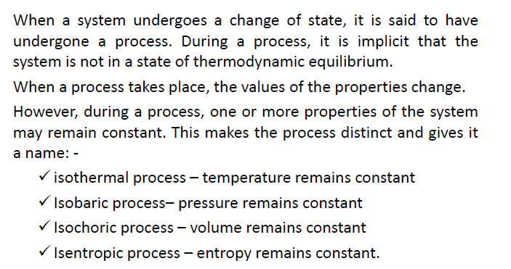
MECHANICAL ENGINEERING SCIENCE
Process

Slide 22
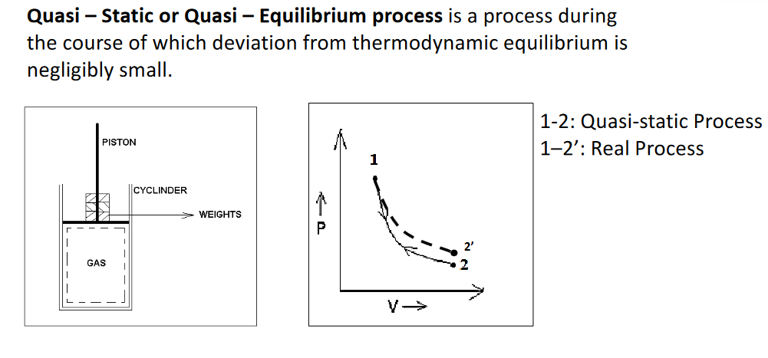
MECHANICAL ENGINEERING SCIENCE
Quasi static or Quasi Equilibrium Process

Slide 23
MECHANICAL ENGINEERING SCIENCE
Quasi static or Quasi Equilibrium Process
In thermodynamics, a quasi-static process, also known as a quasi-equilibrium process ,is a thermodynamic process that happens slowly enough for the system to remain in internal physical (but not necessarily chemical) thermodynamic equilibrium

Slide 24
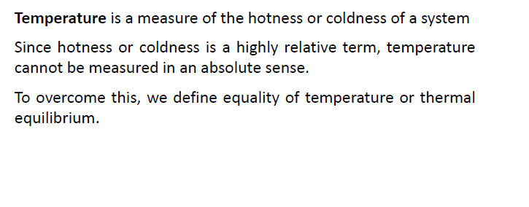
MECHANICAL ENGINEERING SCIENCE
Temperature

Slide 25
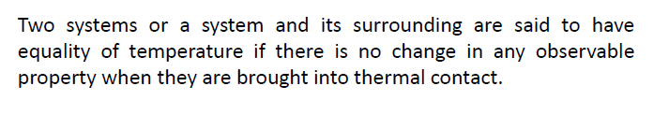
MECHANICAL ENGINEERING SCIENCE
Equality of Temperature

Slide 26
MECHANICAL ENGINEERING SCIENCE
Equality of Temperature
Hot block reduces the temperature and decrease in length.
Cold block increase the temperature and increase in length.
Electrical resistance reduces from hot to cold.

Slide 27
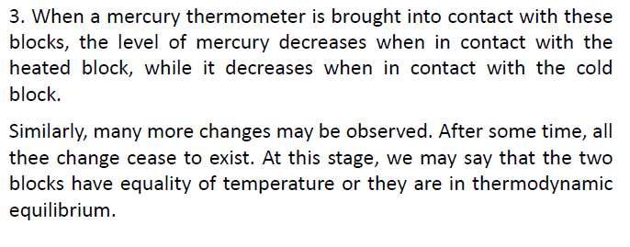
MECHANICAL ENGINEERING SCIENCE
Equality of Temperature

Slide 28
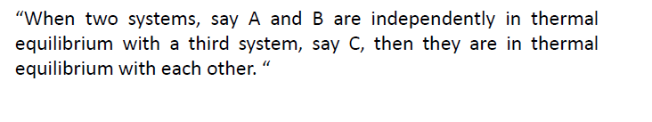
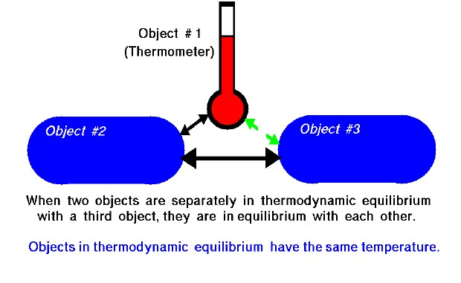
MECHANICAL ENGINEERING SCIENCE
Zeroth Law of Thermodynamics

Slide 29
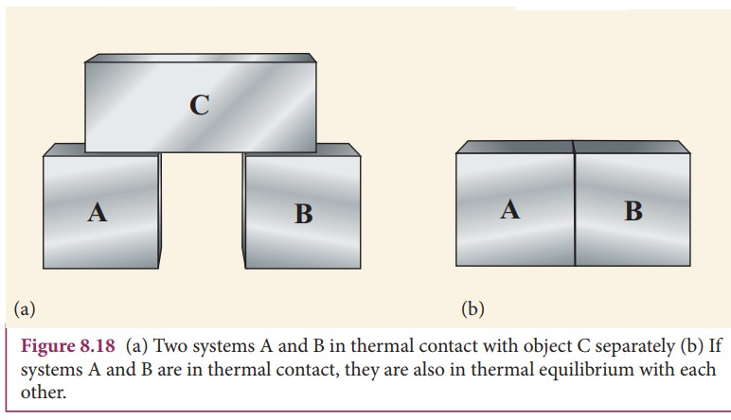
MECHANICAL ENGINEERING SCIENCE
Zeroth Law of Thermodynamics

Slide 30
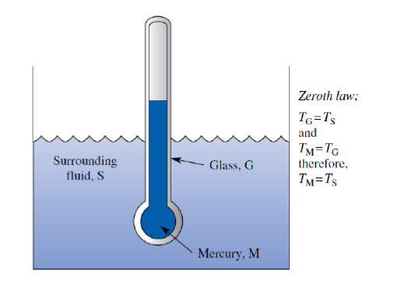
MECHANICAL ENGINEERING SCIENCE
Illustration of Zeroth Law of Thermodynamics as basis for Temperature Measurement

Slide 31
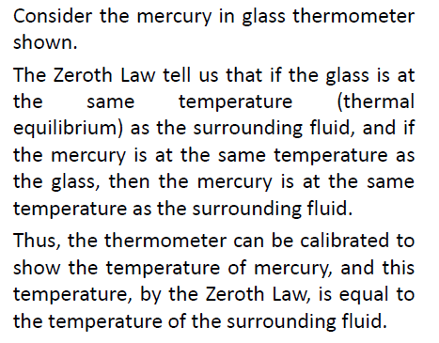
MECHANICAL ENGINEERING SCIENCE
Illustration of Zeroth Law of Thermodynamics as basis for Temperature Measurement

Slide 32
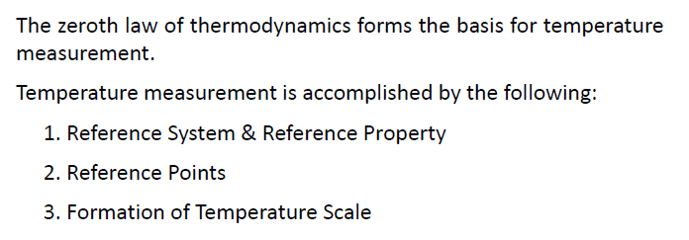
MECHANICAL ENGINEERING SCIENCE
Temperature Measurement

Slide 33
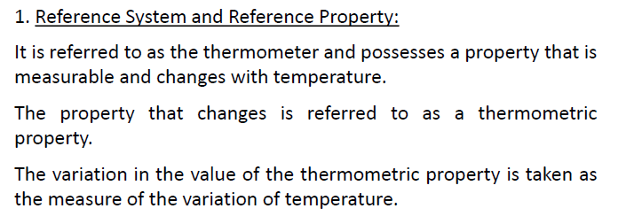
MECHANICAL ENGINEERING SCIENCE
Temperature Measurement

Slide 34
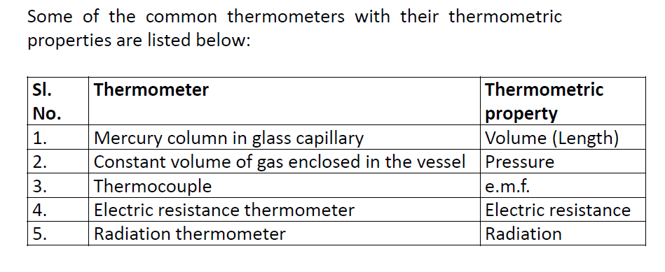
MECHANICAL ENGINEERING SCIENCE
Temperature Measurement

Slide 35
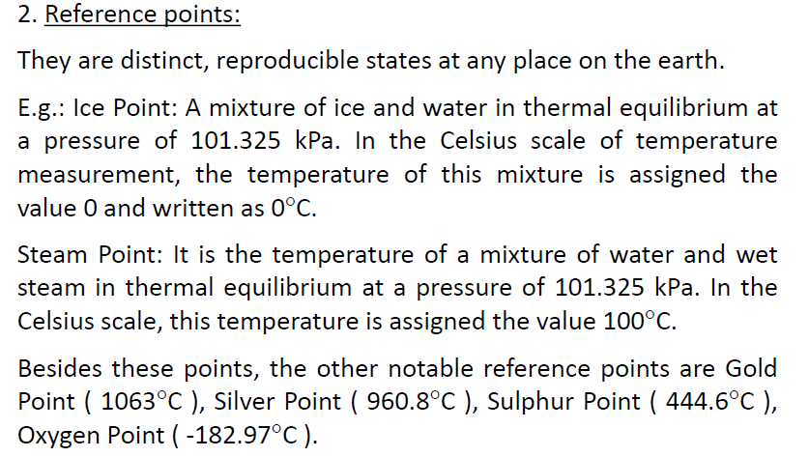
MECHANICAL ENGINEERING SCIENCE
Temperature – Reference Points

Slide 36
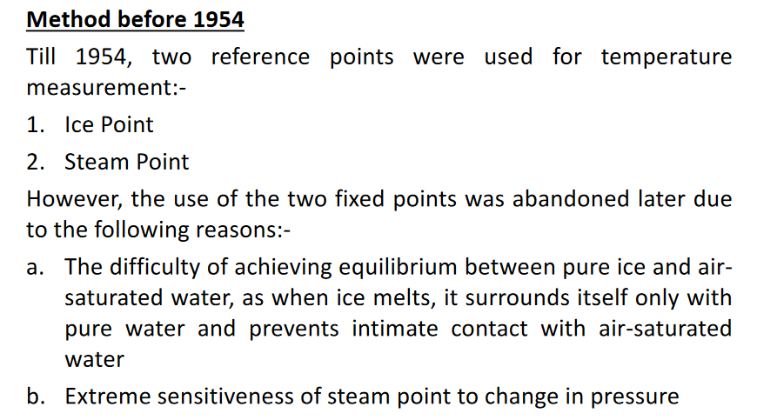
MECHANICAL ENGINEERING SCIENCE
Temperature – Reference Points

Slide 37
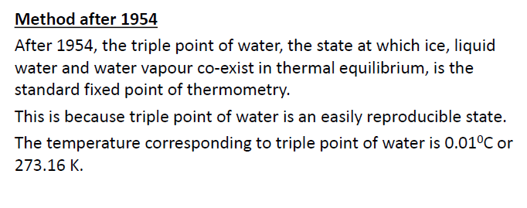
MECHANICAL ENGINEERING SCIENCE
Temperature – Reference Points

Slide 38
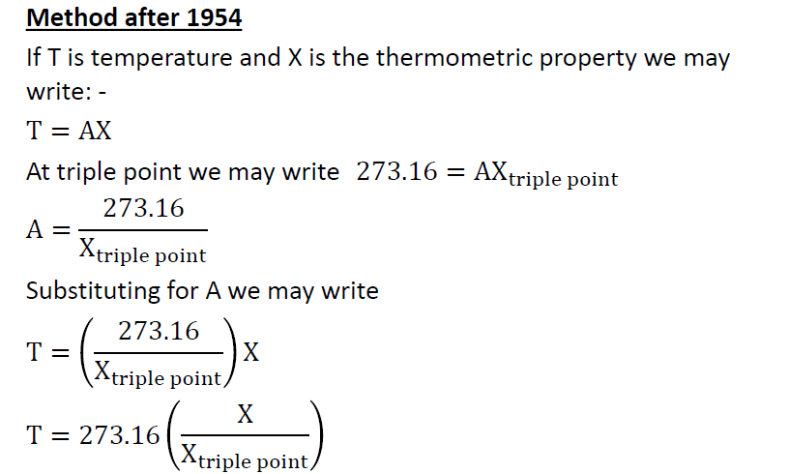
MECHANICAL ENGINEERING SCIENCE
Temperature – Reference Points

Slide 39
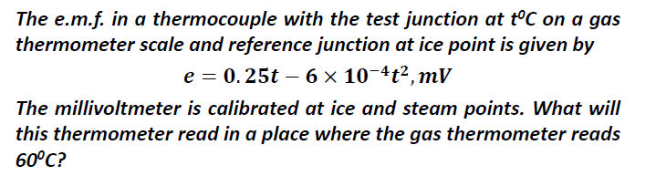
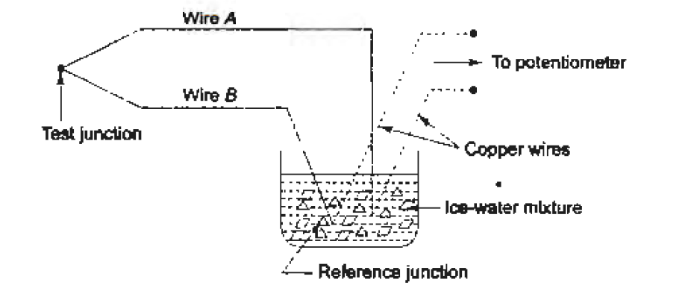
MECHANICAL ENGINEERING SCIENCE
Temperature Measurement - Numericals

Slide 40
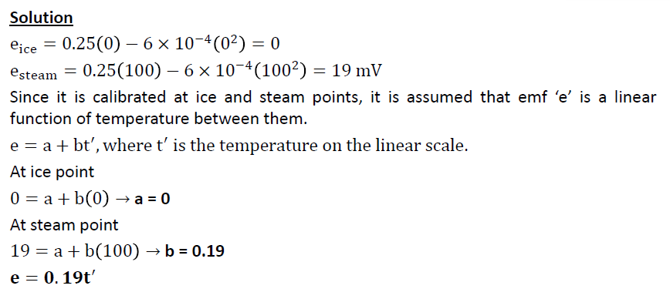
MECHANICAL ENGINEERING SCIENCE
Temperature Measurement - Numericals

Slide 41
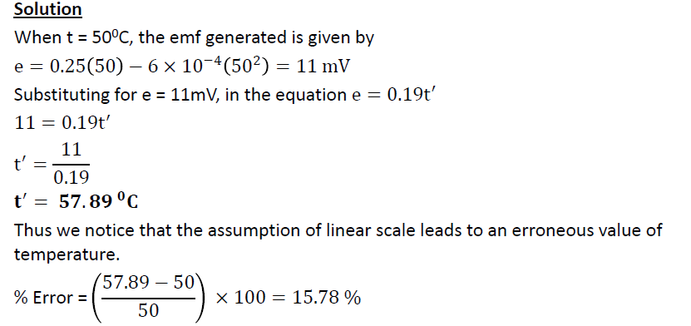
MECHANICAL ENGINEERING SCIENCE
Temperature Measurement - Numericals

Slide 42
MECHANICAL ENGINEERING SCIENCE
Temperature Measurement - Numericals
A thermocouple with test junction at t°C on gas thermometer scale and reference junction at ice point gives the e.m.f. as
e = 0.20 t – 5 × 10^{–4} t² mV.
The millivoltmeter is calibrated at ice and steam points. What will be the reading on this thermometer where the gas thermometer reads 70°C ?

Slide 43
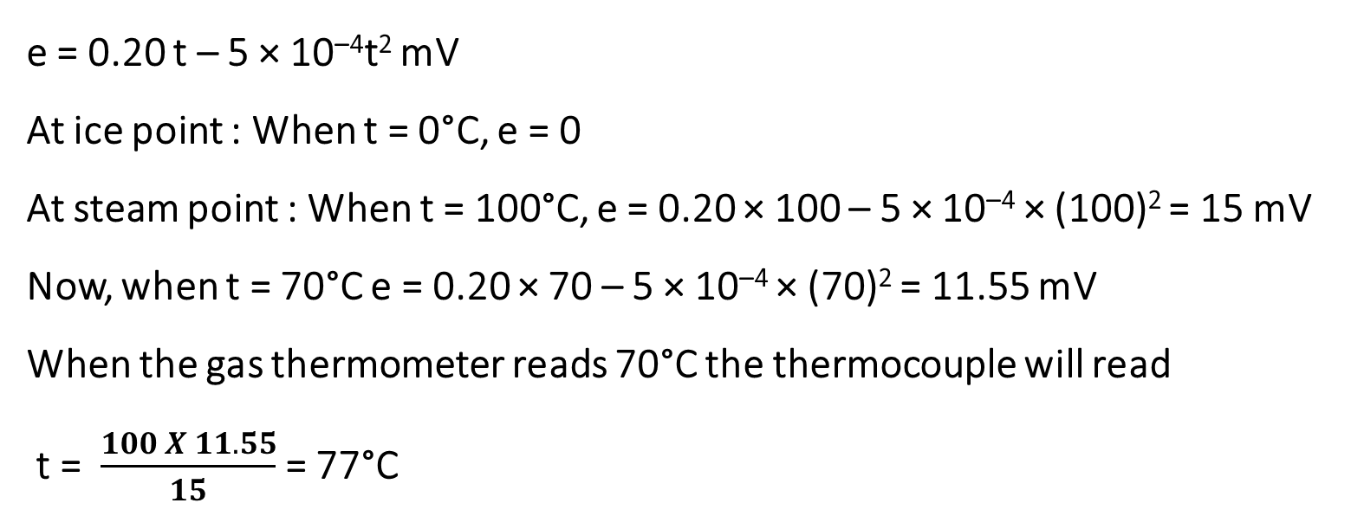
MECHANICAL ENGINEERING SCIENCE
Temperature Measurement - Numericals
e = 0.20 t – 5 × 10^{–4}t² mV
At ice point : When t = 0°C, e = 0
At steam point : When t = 100°C, e = 0.20 × 100 – 5 × 10^{–4} × (100)² = 15 mV
Now, when t = 70°C e = 0.20 × 70 – 5 × 10^{–4} × (70)² = 11.55 mV
When the gas thermometer reads 70°C the thermocouple will read
t = $\frac{100 X 11.55}{15}$ = 77°C

Slide 44
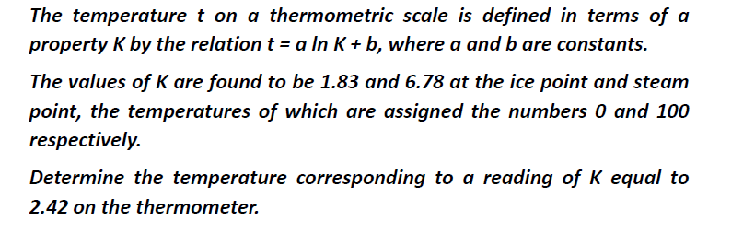
MECHANICAL ENGINEERING SCIENCE
Temperature Measurement - Numericals

Slide 45
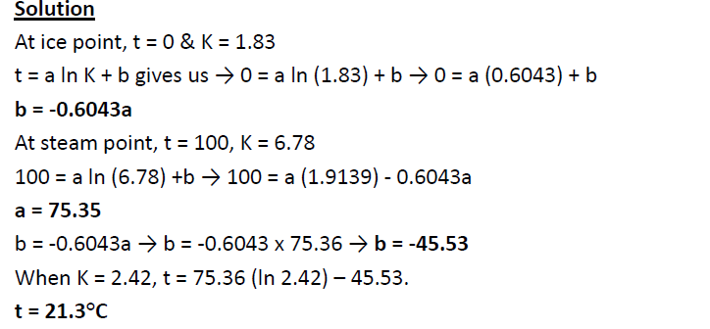
MECHANICAL ENGINEERING SCIENCE
Temperature Measurement - Numericals

Slide 46
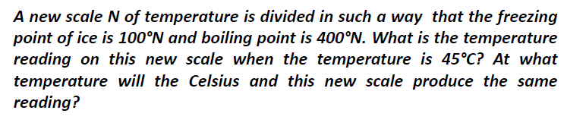
MECHANICAL ENGINEERING SCIENCE
Temperature Measurement - Numericals

Slide 47
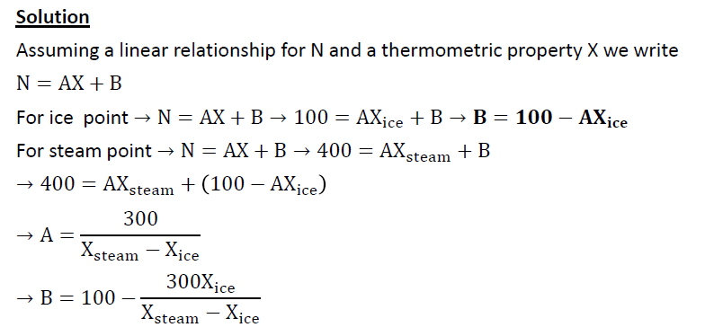
MECHANICAL ENGINEERING SCIENCE
Temperature Measurement - Numericals

Slide 48
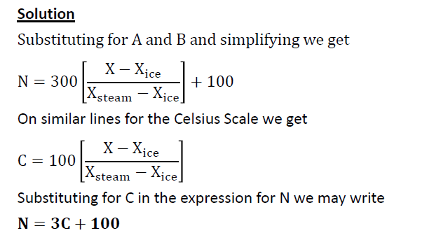
MECHANICAL ENGINEERING SCIENCE
Temperature Measurement - Numericals

Slide 49
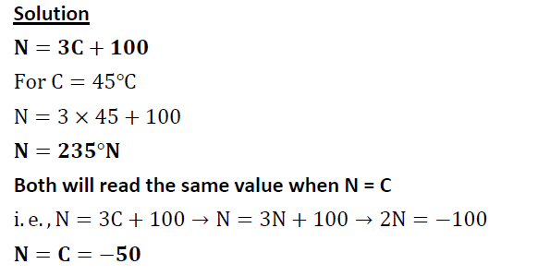
MECHANICAL ENGINEERING SCIENCE
Temperature Measurement - Numericals

Slide 50
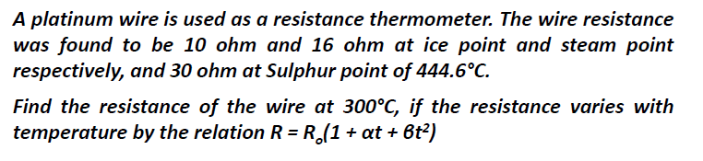
MECHANICAL ENGINEERING SCIENCE
Temperature Measurement - Numericals

Slide 51
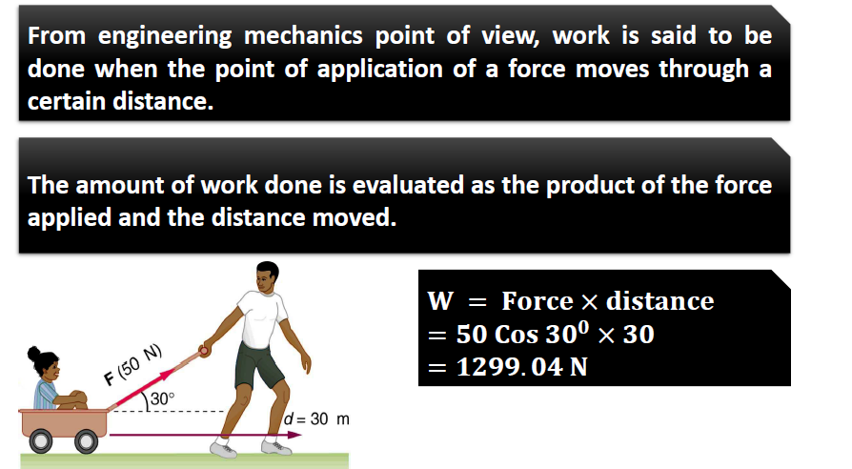
MECHANICAL ENGINEERING SCIENCE
Work

Slide 52
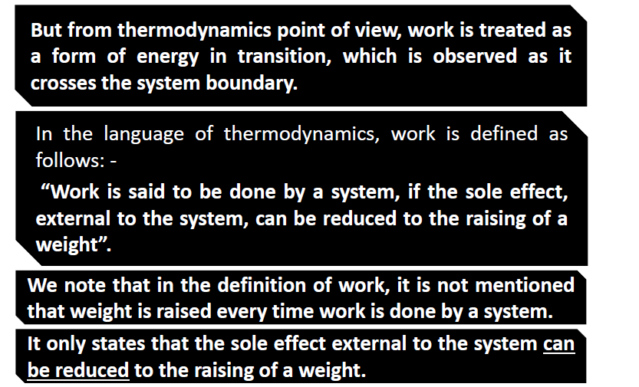
MECHANICAL ENGINEERING SCIENCE
Work

Slide 53
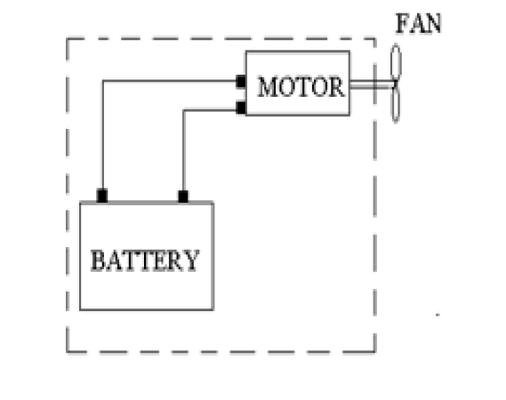
MECHANICAL ENGINEERING SCIENCE
Illustration of Work

Slide 54
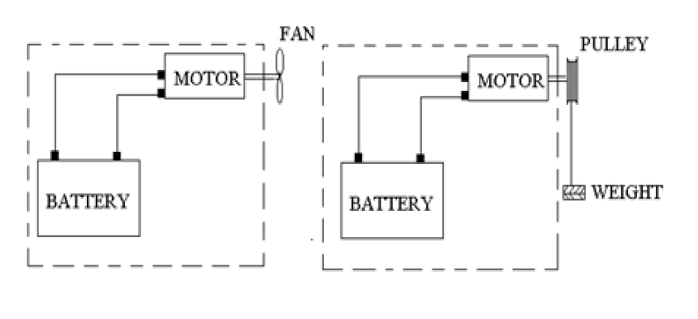
MECHANICAL ENGINEERING SCIENCE
Illustration of Work

Slide 55

MECHANICAL ENGINEERING SCIENCE
Illustration of Work

Slide 56

MECHANICAL ENGINEERING SCIENCE
Sign Conventions of Work

Slide 57

MECHANICAL ENGINEERING SCIENCE
Moving boundary or pdV work

Slide 58

MECHANICAL ENGINEERING SCIENCE
Moving boundary or pdV work

Slide 59

MECHANICAL ENGINEERING SCIENCE
Moving boundary or pdV work

Slide 60

MECHANICAL ENGINEERING SCIENCE
Moving boundary or pdV work

Slide 61

MECHANICAL ENGINEERING SCIENCE
Moving boundary or pdV work for Isothermal Process

Slide 62

MECHANICAL ENGINEERING SCIENCE
Moving boundary or pdV work for Various processes

Slide 63

MECHANICAL ENGINEERING SCIENCE
Other forms of Work

Slide 64

MECHANICAL ENGINEERING SCIENCE
Other forms of Work

Slide 65

MECHANICAL ENGINEERING SCIENCE
Heat

Slide 66

MECHANICAL ENGINEERING SCIENCE
Heat

Slide 67

MECHANICAL ENGINEERING SCIENCE
Sign Convention for Heat

Slide 68

MECHANICAL ENGINEERING SCIENCE
Comparison between Work and Heat

Slide 69

MECHANICAL ENGINEERING SCIENCE
Comparison between Work and Heat – Sign Convention

Slide 70

MECHANICAL ENGINEERING SCIENCE
Numericals on Moving Boundary Work

Slide 71

MECHANICAL ENGINEERING SCIENCE
Numericals on Moving Boundary Work

Slide 72

MECHANICAL ENGINEERING SCIENCE
Numericals on Moving Boundary Work

Slide 73

MECHANICAL ENGINEERING SCIENCE
Numericals on Moving Boundary Work

Slide 74

MECHANICAL ENGINEERING SCIENCE
Numericals on Moving Boundary Work

Slide 75

MECHANICAL ENGINEERING SCIENCE
Numericals on Moving Boundary Work

Slide 76

MECHANICAL ENGINEERING SCIENCE
First Law of Thermodynamics – Joule’s Experiment

Slide 77

MECHANICAL ENGINEERING SCIENCE
First Law of Thermodynamics – Joule’s Experiment

Slide 78

MECHANICAL ENGINEERING SCIENCE
First Law of Thermodynamics – Joule’s Experiment

Slide 79

MECHANICAL ENGINEERING SCIENCE
Statement of First Law of Thermodynamics for Cyclic Process

Slide 80

MECHANICAL ENGINEERING SCIENCE
Statement of First Law of Thermodynamics for Cyclic Process

Slide 81

MECHANICAL ENGINEERING SCIENCE
Statement of First Law of Thermodynamics for Cyclic Process

Slide 82


MECHANICAL ENGINEERING SCIENCE
First Law of Thermodynamics for a closed system undergoing process
It can be shown that the quantity
is a property of the system and we call this property ENERGY with symbol E

Slide 83

MECHANICAL ENGINEERING SCIENCE
First Law of Thermodynamics for a closed system undergoing process

Slide 84

MECHANICAL ENGINEERING SCIENCE
Energy or Stored Energy of a System

Slide 85

MECHANICAL ENGINEERING SCIENCE
Internal Energy of a System

Slide 86

MECHANICAL ENGINEERING SCIENCE
First Law of Thermodynamics - Numericals

Slide 87

MECHANICAL ENGINEERING SCIENCE
First Law of Thermodynamics - Numericals

Slide 88

MECHANICAL ENGINEERING SCIENCE
First Law of Thermodynamics - Numericals

Slide 89

MECHANICAL ENGINEERING SCIENCE
First Law of Thermodynamics - Numericals

Slide 90

MECHANICAL ENGINEERING SCIENCE
First Law of Thermodynamics - Numericals

Slide 91

MECHANICAL ENGINEERING SCIENCE
First Law of Thermodynamics - Limitations

Slide 92

MECHANICAL ENGINEERING SCIENCE
Directional Nature of Processes

Slide 93

MECHANICAL ENGINEERING SCIENCE
Directional Nature of Processes

Slide 94

MECHANICAL ENGINEERING SCIENCE
Directional Nature of Processes

Slide 95

MECHANICAL ENGINEERING SCIENCE
Important Definitions

Slide 96

MECHANICAL ENGINEERING SCIENCE
Important Definitions - Source

Slide 97

MECHANICAL ENGINEERING SCIENCE
Important Definitions - Source

Slide 98

MECHANICAL ENGINEERING SCIENCE
Important Definitions - Sink

Slide 99

MECHANICAL ENGINEERING SCIENCE
Important Definitions - Sink

Slide 100

MECHANICAL ENGINEERING SCIENCE
Important Definitions – Heat Engine

Slide 101

MECHANICAL ENGINEERING SCIENCE
Important Definitions – Reversed Heat Engine

Slide 102

MECHANICAL ENGINEERING SCIENCE
Statement of Second Law of Thermodynamics

Slide 103
MECHANICAL ENGINEERING SCIENCE
REFRIGERATION
PRINCIPLE OF REFRIGERATION
The process of cooling or reducing the temperature of a substance below that of the surrounding atmosphere and maintaining this lower temperature within the boundary of a given space is called refrigeration.
The machine or device employed to produce refrigeration effect is called refrigerator.
In order to keep the substance cold, heat must be continuously removed from the given substance.
According to the law of thermodynamics, heat naturally flows from a hot substance to a cold substance. But if heat has to flow from a cold substance to a hot substance, some form of work has to be performed.

Slide 104

MECHANICAL ENGINEERING SCIENCE
REFRIGERATION
PRINCIPLE OF REFRIGERATION
Refrigeration works on the principle that heat is continuously extracted from the low temperature substance by performing mechanical work. This heat is then rejected to the surrounding atmosphere (high temperature level).
A carrier substance is used to extract the heat and this substance is known as refrigerant.
The refrigerant is a chemical substance like ammonia, carbon di oxide, methyl chloride, Freon etc.

Slide 105


MECHANICAL ENGINEERING SCIENCE
MECHANICAL ENERGY AND EFFICIENCY
Many fluid systems are designed to transport a fluid from one location to another at a specified flow rate, velocity, and elevation difference, and the system may generate mechanical work in a turbine or it may consume mechanical work in a pump or fan during this process.
These systems do not involve the conversion of nuclear, chemical, or thermal energy to mechanical energy. Also, they do not involve heat transfer in any significant amount, and they operate essentially at constant temperature.
Such systems can be analyzed conveniently by considering only the mechanical forms of energy and the frictional effects that cause the mechanical energy to be lost (i.e., to be converted to thermal energy that usually cannot be used for any useful purpose)
The mechanical energy is defined as the form of energy that can be converted to mechanical work completely and directly by an ideal mechanical device such as an ideal turbine.

Slide 106


MECHANICAL ENGINEERING SCIENCE
MECHANICAL ENERGY AND EFFICIENCY
Kinetic and potential energies are the familiar forms of mechanical energy. Thermal energy is not mechanical energy, however, since it cannot be converted to work directly and completely (the second law of thermodynamics).
The mechanical energy of a flowing fluid can be expressed on a unit-mass basis as
where P/ρ is the flow energy, V²/2 is the kinetic energy, and gz is the potential energy of the fluid, all per unit mass. Then the mechanical energy change of a fluid during incompressible flow becomes

Slide 107


MECHANICAL ENGINEERING SCIENCE
MECHANICAL ENERGY AND EFFICIENCY
Therefore, the mechanical energy of a fluid does not change during flow if its pressure, density, velocity, and elevation remain constant.
In the absence of any irreversible losses, the mechanical energy change represents the mechanical work supplied to the fluid (if Δe_{mech} >0) or extracted from the fluid (if Δe_{mech}<0). The maximum (ideal) power generated by a turbine, for example, is Wmax = $\dot{m}∆e_{mech}$

Slide 108

MECHANICAL ENGINEERING SCIENCE
MECHANICAL ENERGY AND EFFICIENCY
The transfer of mechanical energy is usually accomplished by a rotating shaft, and thus mechanical work is often referred to as shaft work.
A pump or a fan receives shaft work (usually from an electric motor) and transfers it to the fluid as mechanical energy (less frictional losses). A turbine, on the other hand, converts the mechanical energy of a fluid to shaft work.
Because of irreversibilities such as friction, mechanical energy cannot be converted entirely from one mechanical form to another, and the mechanical efficiency of a device or process is defined as

Slide 109




MECHANICAL ENGINEERING SCIENCE
MECHANICAL ENERGY AND EFFICIENCY
The degree of perfection of the conversion process between the mechanical work supplied or extracted and the mechanical energy of the fluid is expressed by the pump efficiency and turbine efficiency. In rate form, these are defined as

Slide 110



MECHANICAL ENGINEERING SCIENCE
MECHANICAL ENERGY AND EFFICIENCY
The mechanical efficiency should not be confused with the motor efficiency and the generator efficiency, which are defined as
A pump is usually packaged together with its motor, and a turbine with its generator. Therefore, we are usually interested in the combined or overall efficiency of pump–motor and turbine–generator combinations, which are defined as

Slide 111

MECHANICAL ENGINEERING SCIENCE
MECHANICAL ENERGY AND EFFICIENCY
The water in a large lake is to be used to generate electricity by the installation of a hydraulic turbine–generator. The elevation difference between the free surfaces upstream and downstream of the dam is 50 m. Water is to be supplied at a rate of 5000 kg/s. If the electric power generated is measured to be 1862 kW and the generator efficiency is 95 percent, determine (a) the overall efficiency of the turbine–generator, (b) the mechanical efficiency of the turbine, and (c) the shaft power supplied by the turbine to the generator.

Slide 112

MECHANICAL ENGINEERING SCIENCE
MECHANICAL ENERGY AND EFFICIENCY

Slide 113

MECHANICAL ENGINEERING SCIENCE
MECHANICAL ENERGY AND EFFICIENCY

Slide 114

MECHANICAL ENGINEERING SCIENCE
MECHANICAL ENERGY AND EFFICIENCY
Water is pumped from a lake to a storage tank 18 m above at a rate of 70 L/s while consuming 20.4 kW of electric power. Disregarding any frictional losses in the pipes and any changes in kinetic energy, determine (a) the overall efficiency of the pump–motor unit and (b) the pressure difference between the inlet and the exit of the pump.

Slide 115
MECHANICAL ENGINEERING SCIENCE
Chapter 2 – IC Engines
Srinivasa Prasad K S
Department of Mechanical Engineering

Slide 116
MECHANICAL ENGINEERING SCIENCE
IC ENGINES
The distinctive feature of our civilization today, one that makes it different
from all others, is the wide use of mechanical power. At one time, the primary
source of power for the work of peace or war was chiefly man’s muscles. Later,
animals were trained to help and afterwards the wind and the running stream
were harnessed. But, the great step was taken in this direction when man
learned the art of energy conversion from one form to another. The machine
which does this job of energy conversion is called an ENGINE.

Slide 117
MECHANICAL ENGINEERING SCIENCE
IC ENGINES
ENGINE – An engine is a device which transforms one form of energy into another form.
HEAT ENGINE - Heat engine is a device which transforms the chemical energy of a fuel into thermal energy and utilizes this thermal energy to perform useful work. Thus, thermal energy is converted to mechanical energy in a heat engine.
Heat engines can be broadly classified into two categories:
(i) Internal Combustion Engines (IC Engines)
(ii) External Combustion Engines (EC Engines)

Slide 118

MECHANICAL ENGINEERING SCIENCE
IC ENGINES
External combustion engines are those in which combustion takes place outside the engine.
For example, in a steam engine or a steam turbine, the heat generated due to the combustion of fuel is employed to generate high pressure steam which is used as the working fluid in a reciprocating engine or a turbine.

Slide 119

MECHANICAL ENGINEERING SCIENCE
IC ENGINES
Internal combustion engines are those in which combustion takes place within the engine.
For example, in case of petrol or diesel engines, the products of combustion generated by the combustion of fuel and air within the cylinder form the working fluid.

Slide 120
MECHANICAL ENGINEERING SCIENCE
IC ENGINES
CLASSIFICATION OF IC ENGINES - There are several criteria for classiﬁcation of I.C. engines. Some of the important criteria can be explained as:
▶ Number of strokes per cycle
▶ Nature of thermodynamic cycle
▶ Ignition systems
▶ Fuel used
▶ Arrangement of cylinders
▶ Cooling systems
▶ Fuel supply systems

Slide 121



MECHANICAL ENGINEERING SCIENCE
IC ENGINES
Number of Strokes Per Cycle:
I.C. engines can be classiﬁed as four-stroke engines (4S) and two-stroke engines (2S).
In four-stroke engines, the thermodynamic cycle is completed in four strokes of the piston or two revolutions of the crankshaft whereas, in two-stroke engines, the thermodynamic cycle is completed in two strokes of the piston or one revolution of the crankshaft.
Nature of Thermodynamic Cycle:
I.C. engines can be classiﬁed as Otto cycle, Diesel cycle, and Dual cycle engines.

Slide 122
MECHANICAL ENGINEERING SCIENCE
IC ENGINES
Ignition Systems:
There are two modes of ignition of fuel inside the cylinder — spark ignition and compression ignition.
In spark ignition, sparking starts at the end of compression stroke from spark plug while in compression ignition the temperature of the fuel is increased to the self-ignition point by compressing the air alone and at the end of compression, fuel is injected into the cylinder.
Fuel Used:
On the basis of fuel used, I.C. Engines can be classiﬁed as (a) Gas engines like CNG, LPG, etc. (b) Petrol engine, (c) Diesel engine, and (d) Bi-fuel engine. In a bi-fuel engine, two types of fuels are used like gaseous fuel and liquid fuel.

Slide 123

MECHANICAL ENGINEERING SCIENCE
IC ENGINES
Arrangement of Cylinders:
Another common method of classifying IC engines is by the cylinder arrangement. The cylinder arrangement is only applicable to multi cylinder engines.
A number of cylinder arrangements are popular with designers. The details of various cylinder arrangements are shown.

Slide 124


MECHANICAL ENGINEERING SCIENCE
IC ENGINES
In-line Engine : The in-line engine is an engine with one cylinder bank, i.e. all cylinders are arranged linearly, and transmit power to a single crankshaft. This type is quite common with automobile engines. Four and six cylinder in-line engines are popular in automotive applications.
‘V’ Engine : In this engine there are two banks of cylinders (i.e., two in line engines) inclined at an angle to each other and with one crankshaft. Most of the high powered automobiles use the 8 cylinder ‘V’ engine, four in-line on each side of the ‘V’. Engines with more than six cylinders generally employ this configuration.

Slide 125


MECHANICAL ENGINEERING SCIENCE
IC ENGINES
Opposed Cylinder Engine : This engine has two cylinder banks located in the same plane on opposite sides of the crankshaft. It can be visualized as two ‘in-line’ arrangements 180 degrees apart. It is inherently a well balanced engine and has the advantages of a single crankshaft. This design is used in small aircrafts.
Opposed Piston Engine : When a single cylinder houses two pistons, each of which driving a separate crankshaft, it is called an opposed piston engine. The movement of the pistons is synchronized by coupling the two crankshafts. Opposed piston arrangement, like opposed cylinder arrangement is inherently well balanced.

Slide 126


MECHANICAL ENGINEERING SCIENCE
IC ENGINES
Radial Engine :
Radial engine is one where more than two cylinders in each row are equally spaced around the crankshaft. The radial arrangement of cylinders is most commonly used in conventional air-cooled aircraft engines. Pistons of all the cylinders are coupled to the same crankshaft.

Slide 127


MECHANICAL ENGINEERING SCIENCE
IC ENGINES
Cooling Systems:
There are two types of cooling systems in I.C. Engines—water cooling and air cooling.
In water cooling, coolant and radiators are provided to cool the cylinder. In air cooling, ﬁns are provided on the surface of the cylinder to radiate the heat into the atmosphere. Low power engines like motorbikes are equipped with air cooling systems, whereas large power producing engines like a car, bus, truck, etc. are equipped with water cooling systems.

Slide 128
MECHANICAL ENGINEERING SCIENCE
IC ENGINES
Fuel Supply Systems:
On the basis of fuel supply systems, I.C. Engines can be classiﬁed as:
(a) Carburetor engine,
(b) Air injection engine, and
(c) Airless or solid or Mechanical injection engines.
In a carburetor engine, air and fuel are properly mixed into the carburetor and then fed into the cylinder. In air injection engines, fuel is supplied to the cylinder with the help of compressed air. In mechanical injection engines, the fuel is injected into the cylinder with the help of mechanical pump and nozzle.

Slide 129

MECHANICAL ENGINEERING SCIENCE
IC ENGINES
BASIC STRUCTURE OF AN IC ENGINE:

Slide 130


MECHANICAL ENGINEERING SCIENCE
IC ENGINES
Cylinder:
It is a hollow cylindrical structure closed at one end with the cylinder head.
The combustion of the fuel takes place inside the cylinder. This is known as the heart of the engine. It is made of hard and high thermal conductivity materials by casting. A piston reciprocates inside the cylinder and produces power.
Cylinder Head: It covers one end of the cylinder and consists of valves/ports and spark plug/injector.

Slide 131

MECHANICAL ENGINEERING SCIENCE
IC ENGINES
Piston:
It is a cylindrical component which is ﬁtted perfectly inside the cylinder providing a gas-tight space with the piston rings and the lubricant.
The piston is connected to connecting rod by gudgeon pin. The main function of the piston is to transfer the power produced by combustion of the fuel to the crankshaft.
Piston Rings:
The outer periphery of the piston is provided with several grooves into which piston rings are ﬁtted. The piston is ﬁtted with these rings. The upper ring is known as compression ring and the lower rings are known as oil rings.
The function of the compression ring is to compress the air or air-fuel mixture and the function of the oil rings is to collect the surplus lubricating oil on the liner surface.

Slide 132


MECHANICAL ENGINEERING SCIENCE
IC ENGINES
Connecting Rod:
It connects the piston and the crankshaft. One end, called the small end, is connected to the gudgeon pin located in the piston and the other end, called big end, is connected to crank pin.
The function of the connecting rod is to transfer the reciprocating motion of the piston into rotary motion of the crankshaft.
Crankshaft:
It is principal rotating part of the engine which controls the sequence of reciprocating motion of the pistons. It consists of several bearings and crank pins.

Slide 133

MECHANICAL ENGINEERING SCIENCE
IC ENGINES
Valves:
Normally, the two valves are used for each cylinder, which may be of mushroom shaped poppet type.
They are provided on the cylinder head for regulating the charge coming into the cylinder and for discharging the products of combustion from the cylinder. The valve mechanism consists of cams, cam follower, push rod, rocker arms, and spring.

Slide 134


MECHANICAL ENGINEERING SCIENCE
IC ENGINES
Crankcase:
The bottom portion of the cylinder block is called crankcase. A cover called crankcase which becomes a sump for lubricating oil is fastened to the bottom of the cylinder block.
Flywheel:
It is a heavy wheel mounted on the crankshaft to minimize the cyclic variations in speed. It absorbs the energy during the power stroke and releases it during the non-power stroke.

Slide 135

MECHANICAL ENGINEERING SCIENCE
IC ENGINES
NOMENCLATURE:
Cylinder Bore (d) : The nominal inner diameter of the working cylinder is called the cylinder bore and is designated by the letter d.
Piston Area (A) : The area of a circle of diameter equal to the cylinder bore is called the piston area and is designated by the letter A.
Stroke (L) : The nominal distance through which a working piston moves between two successive reversals of its direction of motion is called the stroke and is designated by the letter L.
Dead Centre : The position of the working piston and the moving parts which are mechanically connected to it, at the moment when the direction of the piston motion is reversed at either end of the stroke is called the dead centre.

Slide 136

MECHANICAL ENGINEERING SCIENCE
IC ENGINES
NOMENCLATURE:
There are two dead centres in the engine as indicated in Fig. They
are:
Top Dead Centre (ii) Bottom Dead Centre
(i) Top Dead Centre (TDC) : It is the dead centre when the piston is farthest from the crankshaft.
(ii) Bottom Dead Centre (BDC) : It is the dead centre when the piston is nearest to the crankshaft.
Displacement or Swept Volume (Vs) : The nominal volume swept by the working piston when travelling from one dead centre to the other is called the displacement volume. It is usually expressed in terms of cubic centimeter (cc).

Slide 137

MECHANICAL ENGINEERING SCIENCE
IC ENGINES
NOMENCLATURE:
Clearance Volume (Vc): The nominal volume of the combustion chamber above the piston when it is at the top dead centre is the clearance volume.
Compression Ratio (r) : It is the ratio of the total cylinder volume when the piston is at the bottom dead centre, Vt , to the clearance volume, Vc.

Slide 138

MECHANICAL ENGINEERING SCIENCE
IC ENGINES
WORKING PRINCIPLE OF 4S PETROL ENGINE (SPARK IGNITION ENGINE)
In a four-stroke engine, the cycle of operations is completed in four strokes of the piston or two revolutions of the crankshaft.
During the four strokes, there are five events to be completed, viz., suction, compression, combustion, expansion and exhaust. Each stroke consists of 180ᵒ of crankshaft rotation and hence a four-stroke cycle is completed through 720ᵒ of crank rotation.
The cycle of operation for an ideal four-stroke SI engine consists of the following four strokes :
(i) suction or intake stroke;
(ii) compression stroke;
(iii) expansion or power stroke and
(iv) exhaust stroke.

Slide 139


MECHANICAL ENGINEERING SCIENCE
IC ENGINES
WORKING PRINCIPLE OF 4S PETROL ENGINE
Suction Stroke:
Suction stroke 0→1 starts when the piston is at the top dead centre and about to move downwards.
The inlet valve is assumed to open instantaneously and at this time the exhaust valve is in the closed position.
Due to the suction created by the motion of the piston towards the bottom dead centre, the charge consisting of fuel-air mixture is drawn into the cylinder.
When the piston reaches the bottom dead centre the suction stroke ends and the inlet valve closes instantaneously.

Slide 140

MECHANICAL ENGINEERING SCIENCE
IC ENGINES
WORKING PRINCIPLE OF 4S PETROL ENGINE
Compression Stroke:
The charge taken into the cylinder during the suction stroke is compressed by the return stroke of the piston 1→2.
During this stroke both inlet and exhaust valves are in closed position.
The mixture which fills the entire cylinder volume is now compressed into the clearance volume.

Slide 141

MECHANICAL ENGINEERING SCIENCE
IC ENGINES
WORKING PRINCIPLE OF 4S PETROL ENGINE
Compression Stroke:
At the end of the compression stroke the mixture is ignited with the help of a spark plug located on the cylinder head.
In ideal engines it is assumed that burning takes place instantaneously when the piston is at the top dead centre and hence the burning process can be approximated as heat addition at constant volume.
During the burning process the chemical energy of the fuel is converted into heat energy producing a temperature rise of about 2000ᵒC (process 2→3).
The pressure at the end of the combustion process is considerably increased due to the heat release from the fuel.

Slide 142

MECHANICAL ENGINEERING SCIENCE
IC ENGINES
WORKING PRINCIPLE OF 4S PETROL ENGINE
Expansion or Power Stroke :
The high pressure of the burnt gases forces the piston towards the BDC, (stroke 3→4).
Both the valves are in closed position.
Of the four-strokes only during this stroke power is produced. Both pressure and temperature decrease during expansion.

Slide 143

MECHANICAL ENGINEERING SCIENCE
IC ENGINES
WORKING PRINCIPLE OF 4S PETROL ENGINE
Exhaust Stroke:
At the end of the expansion stroke the exhaust valve opens instantaneously and the inlet valve remains closed.
The pressure falls to atmospheric level a part of the burnt gases escape.
The piston starts moving from the bottom dead centre to top dead centre (stroke 5→0) and sweeps the burnt gases out from the cylinder almost at atmospheric pressure.
The exhaust valve closes when the piston reaches TDC.

Slide 144

MECHANICAL ENGINEERING SCIENCE
IC ENGINES
WORKING PRINCIPLE OF 4S DIESEL ENGINE (COMPRESSION IGNITION ENGINE)
The four-stroke CI engine is similar to the four-stroke SI engine but it operates at a much higher compression ratio. The compression ratio of an SI engine is between 6 and 10 while for a CI engine it is from 16 to 20.
In the CI engine during suction stroke, air, instead of a fuel-air mixture, is inducted.
Due to higher compression ratios employed, the temperature at the end of the compression stroke is sufficiently high to self ignite the fuel which is injected into the combustion chamber.
In CI engines, a high pressure fuel pump and an injector are provided to inject the fuel into the combustion chamber. The carburettor and ignition system necessary in the SI engine are not required in the CI engine.

Slide 145


MECHANICAL ENGINEERING SCIENCE
IC ENGINES
WORKING PRINCIPLE OF 4S DIESEL ENGINE
Suction Stroke: Air alone is inducted during the suction stroke. During
this stroke inlet valve is open and exhaust valve is closed.
Compression Stroke: Air inducted during the suction stroke is compressed into the clearance volume. Both valves remain closed during this stroke.

Slide 146


MECHANICAL ENGINEERING SCIENCE
IC ENGINES
WORKING PRINCIPLE OF 4S DIESEL ENGINE
Expansion Stroke : Fuel injection starts nearly at the end of the compression stroke.
The rate of injection is such that combustion maintains the pressure constant in spite of the piston movement on its expansion stroke increasing the volume. Heat is assumed to have been added at constant pressure.
After the injection of fuel is completed (i.e. after cut-off) the products of combustion expand. Both the valves remain closed during the expansion stroke.

Slide 147

MECHANICAL ENGINEERING SCIENCE
IC ENGINES
WORKING PRINCIPLE OF 4S DIESEL ENGINE
Exhaust Stroke :
The piston travelling from BDC to TDC pushes out the products of combustion.
The exhaust valve is open and the intake valve is closed during this stroke.

Slide 148
MECHANICAL ENGINEERING SCIENCE
IC ENGINES
COMPARISON OF PETROL AND DIESEL ENGINES
Description | Petrol Engine (SI Engine) | Diesel Engine (CI Engine)
Basic cycle | Works on Otto cycle or constant volume heat addition cycle. | Works on Diesel cycle or constant pressure heat addition cycle.
Fuel | Petrol, a highly volatile fuel. Self-ignition temperature is high. | Diesel oil, a non-volatile fuel. Self-ignition temperature is comparatively low.
Introduction of fuel | A gaseous mixture of fuel-air is introduced during the suction stroke. A carburettor and an ignition system are necessary. Modern engines have petrol injection | Fuel is injected directly into the combustion chamber at high pressure at the end of the compression stroke. A fuel pump and injector are necessary.

Slide 149
MECHANICAL ENGINEERING SCIENCE
IC ENGINES
COMPARISON OF PETROL AND DIESEL ENGINES
Description | Petrol Engine (SI Engine) | Diesel Engine (CI Engine)
Ignition | Requires an ignition system with spark plug in the combustion chamber. | Self-ignition occurs due to high temperature of air because of the high compression.
Compression ratio | 6 to 10. Upper limit is fixed by antiknock quality of the fuel. | 16 to 20. Upper limit is limited by weight increase of the engine.
Speed | Due to light weight they are high speed engines. | Due to heavy weight they are low speed engines.
Thermal efficiency | Because of the lower CR, the maximum value of thermal efficiency that can be obtained is lower. | Because of higher CR, the maximum value of thermal efficiency that can be obtained is higher.

Slide 150
MECHANICAL ENGINEERING SCIENCE
IC ENGINES
COMPARISON OF PETROL AND DIESEL ENGINES
Description | Petrol Engine (SI Engine) | Diesel Engine (CI Engine)
Weight | Lighter due to comparatively lower peak pressures. | Heavier due to comparatively higher peak pressures.

Slide 151
MECHANICAL ENGINEERING SCIENCE
IC ENGINES
APPLICATIONS OF IC ENGINES
The most important application of IC engines is in transport on land, sea and air. Other applications include industrial power plants and as prime movers for electric generators.
4S Petrol Engines:
The most important application of small four-stroke petrol engines is in automobiles. A typical automobile is powered by a four-stroke four cylinder engine developing an output in the range of 30-60 kW at a speed of about 4500 rpm.
Another application of four-stroke petrol engine is in small pumping sets and mobile electric generating sets.
Smaller aircrafts normally employ four-stroke gasoline (SI) radial engines.

Slide 152
MECHANICAL ENGINEERING SCIENCE
IC ENGINES
APPLICATIONS OF IC ENGINES
4S Diesel Engines:
The four-stroke diesel engine is one of the most efficient and versatile prime movers. It is manufactured in sizes from 50 mm to more than 1000 mm of cylinder diameter and with engine speeds ranging from 100 to 4500 rpm while delivering outputs from 1 to 35000 kW.
Small diesel engines are used in pump sets, construction machinery, air compressors, drilling rigs and many miscellaneous applications.
Tractors for agricultural application use about 30 kW diesel engines whereas jeeps, buses and trucks use 40 to 100 kW diesel engines.
Diesel engines are used both for mobile and stationary electric generating plants of varying capacities.

Slide 153
MECHANICAL ENGINEERING SCIENCE
IC ENGINES
PERFORMANCE PARAMETERS OF IC ENGINES
The following factors are to be considered in evaluating the performance of an engine:
(i) Maximum power or torque
(ii) Specific fuel consumption
(iii) Reliability and durability
Engine performance characteristics can be determined by the following two methods.
(i) By using experimental results obtained from engine tests.
(ii) By analytical calculation based on theoretical data.

Slide 154
MECHANICAL ENGINEERING SCIENCE
IC ENGINES
PERFORMANCE PARAMETERS OF IC ENGINES
Engine Power
The energy flow through the engine is expressed in three distinct terms. They are indicated power, IP, friction power FP and brake power, BP.
Indicated power can be computed from the measurement of forces in the cylinder and brake power may be computed from the measurement of forces at the crankshaft of the engine. Friction power can be calculated with the above two values.

Slide 155
MECHANICAL ENGINEERING SCIENCE
IC ENGINES
PERFORMANCE PARAMETERS OF IC ENGINES
ii) Indicated Power - The power developed inside the cylinder of the engine is called the indicated power (IP).

Slide 156

MECHANICAL ENGINEERING SCIENCE
IC ENGINES
PERFORMANCE PARAMETERS OF IC ENGINES
iii) Brake Power – It is the net power available at the crank shaft of the engine for performing useful work (BP).
It is always less than indicated power since a part of the power developed in the engine cylinder is used to overcome the frictional losses at different moving parts of the engine.
Brake power of an engine can be determined by a brake of some kind applied to the brake pulley of the engine. The arrangement used for determination of BP of the engine is known as dynamometer. Usually, rope brake dynamometer is used for this purpose.
BP is given by,
$BP= \frac{2πNT}{60×1000} (expressed in kW)$ where $N$ = Crank speed in rpm; $T$ = Torque in N-m

Slide 157

MECHANICAL ENGINEERING SCIENCE
IC ENGINES
PERFORMANCE PARAMETERS OF IC ENGINES
The rope brake dynamometer consists of rope wrapped round the brake drum or flywheel keyed to crankshaft of an engine whose BP is to be determined.
One end of the rope is connected to the spring balance (with reading ‘S’) while at the other end is hung a weight W.
Wooden blocks are incorporated to check the rope slipping off the brake drum/flywheel.
It is evident from the figure that the net brake load which opposes the rotation is (W-S) and the effective radius at which the net load acts = (D+d)/2, where D is the diameter of the brake drum and d is the diameter of the rope.

Slide 158


MECHANICAL ENGINEERING SCIENCE
IC ENGINES
PERFORMANCE PARAMETERS OF IC ENGINES
Therefore,

Slide 159

MECHANICAL ENGINEERING SCIENCE
IC ENGINES
PERFORMANCE PARAMETERS OF IC ENGINES
iv) Friction Power – It is the difference between the indicated power and brake power.
FP = IP – BP
Apart from expressing engine performance in terms of power, it is also essential to express in terms of efficiencies.
v) Mechanical efficiency - Mechanical efficiency takes into account the mechanical losses in an engine like friction losses in case of pistons, bearings, gears, valve mechanisms, losses due to absorption of power by fuel pump, oil pump, radiator etc. In general, mechanical efficiency of engines varies from 65 to 85%.
It is defined as the ratio of brake power to indicated power.
$$_{mech}= \frac{Brake power \left(BP\right)}{Indicated power \left(IP\right)}$$

Slide 160

MECHANICAL ENGINEERING SCIENCE
IC ENGINES
PERFORMANCE PARAMETERS OF IC ENGINES
vi) Thermal efficiency – It gives an idea of the output generated by the engine with respect to heat supplied in the form of fuel.
Thermal efficiency is expressed in two ways, viz., indicated thermal efficiency and brake thermal efficiency.
Indicated thermal efficiency = $_{ith}$ = $\frac{IP}{CV × m_{f}}$
Brake thermal efficiency = $_{bth}$ = $\frac{BP}{CV × m_{f}}$ $×100$ CV is the calorific value of the fuel in KJ/kg and mf is mass flow rate of the fuel in kg/s. IP and BP are in kW.

Slide 161

MECHANICAL ENGINEERING SCIENCE
IC ENGINES
PERFORMANCE PARAMETERS OF IC ENGINES
vii) Specific fuel consumption – It is the mass of fuel consumed per kW of power developed per hour and is a criterion of economical power production.
Specific fuel consumption is expressed in two ways, viz., indicated specific fuel consumption (ISFC) and brake specific fuel consumption (BSFC).
ISFC = $\frac{Mass of fuel consumed in kg/hr}{Indicated Power in kW}$
BSFC = $\frac{Mass of fuel consumed in kg/hr}{Brake Power in kW}$

Slide 162
MECHANICAL ENGINEERING SCIENCE
IC ENGINES
PERFORMANCE PARAMETERS OF IC ENGINES - NUMERICALS
The following data refers to a test on a single cylinder engine working on four stroke cycle:
Diameter of brake drum = 60 cm
Rope diameter = 3 cm
Load on brake drum = 25 kg
Spring balance reading = 5 kg
Speed of engine = 400 rpm
Bore = 10 cm
Stroke = 15 cm
Indicated Power = 3.141 kW
Calculate (i) Brake Power (ii) Mechanical Efficiency

Slide 163

MECHANICAL ENGINEERING SCIENCE
IC ENGINES
PERFORMANCE PARAMETERS OF IC ENGINES - NUMERICALS
1) Brake Power (BP)
Torque = $T=\left(W−S\right)×\left(\frac{D_{b}+d_{r}}{2}\right)=\left(25−5\right)×9.81×\left(\frac{0.6+0.03}{2}\right)=61.803 Nm$
Brake Power = $BP= \frac{2πNT}{60×1000}=\frac{2×π×400×61.803}{60×1000}=2.589 kW$
2) Mechanical Efficiency
$η_{mech}=\frac{BP}{IP} = \frac{2.589}{3.141}=0.8241 or 82.41\%$

Slide 164
MECHANICAL ENGINEERING SCIENCE
IC ENGINES
PERFORMANCE PARAMETERS OF IC ENGINES - NUMERICALS
2) The following observations are taken during a trial on four stroke diesel engine.
Cylinder diameter = 25 cm
Stroke = 40 cm
Speed = 250 rpm
Brake load = 70 kg
Brake drum diameter = 2m
Diesel oil consumption = 0.1 litres/min
Specific gravity of fuel = 0.78
Calorific value of fuel = 43900 kJ/kg
Indicated Power = 24.54 kW
Determine (i) Brake Power (ii) Mechanical efficiency (iii) Brake thermal
efficiency (iv) Indicated thermal efficiency.

Slide 165

MECHANICAL ENGINEERING SCIENCE
IC ENGINES
PERFORMANCE PARAMETERS OF IC ENGINES - NUMERICALS
Solution:
1) Brake Power
We know that brake power is given by
$BP=\frac{2πNT}{60000}=\frac{2×π×250×70×9.81×1}{60000}=17.98 kW$

Slide 166

MECHANICAL ENGINEERING SCIENCE
IC ENGINES
PERFORMANCE PARAMETERS OF IC ENGINES - NUMERICALS
Solution:
2) Mechanical efficiency
We know that mechanical efficiency is given by,
$η_{mech}=\frac{BP}{IP}=73.3\%$
3) Brake Thermal Efficiency
We know that brake thermal efficiency is given by,
$η_{Bth}=\frac{BP}{m_{f}×CV}=\frac{17.98}{\frac{0.1×0.78×1000}{1000×60}×43900}=31.5\%$

Slide 167

MECHANICAL ENGINEERING SCIENCE
IC ENGINES
PERFORMANCE PARAMETERS OF IC ENGINES - NUMERICALS
Solution:
4) Indicated Thermal Efficiency
We know that indicated thermal efficiency is given by,
$η_{Ith}=\frac{IP}{m_{f}×CV}=\frac{24.54}{\frac{0.1×0.78×1000}{1000×60}×43900}=43\%$

Slide 168
MECHANICAL ENGINEERING SCIENCE
IC ENGINES
PERFORMANCE PARAMETERS OF IC ENGINES - NUMERICALS
3) A four cylinder four stroke petrol engine develops 30 kW at 2500 rpm. The mean effective pressure on each piston is 8 bar and mechanical efficiency is 80%. Calculate the diameter and stroke of each cylinder.

Slide 169

MECHANICAL ENGINEERING SCIENCE
IC ENGINES
PERFORMANCE PARAMETERS OF IC ENGINES - NUMERICALS
Solution:
We know that,
$$η_{mech}=\frac{BP}{IP}$$
Therefore,
$$IP=\frac{BP}{η_{mech}}= \frac{30}{0.8}=37.5 kW$$
Also, $IP= \frac{np_{m}LANK}{60×1000}$

Slide 170

MECHANICAL ENGINEERING SCIENCE
IC ENGINES
PERFORMANCE PARAMETERS OF IC ENGINES - NUMERICALS
Solution:
$$37.5= \frac{4×8×{10}^{5}×L×(\frac{π}{4}d^{2})×2500×(\frac{1}{2})}{60×1000}$$
$$7.16×{10}^{−4}=Ld^{2}$$
From data, L/d = 1.5 or L = 1.5d
Therefore,
$$7.16×{10}^{−4}=(1.5d)d^{2}$$
This gives, d = 0.078 m = 78 mm; L = 1.5d = 117 mm

Slide 171
MECHANICAL ENGINEERING SCIENCE
IC ENGINES
PERFORMANCE PARAMETERS OF IC ENGINES - NUMERICALS
4) A diesel engine develops 5 kW. Its indicated thermal efficiency is 30% and mechanical efficiency is 75%. Estimate the fuel consumption of the engine in a) kg/hr and b) litres/hr. Also find ISFC and BSFC. Take CV of fuel = 42000 kJ/kg and specific gravity of fuel = 0.87.

Slide 172
MECHANICAL ENGINEERING SCIENCE
IC ENGINES
PERFORMANCE PARAMETERS OF IC ENGINES - NUMERICALS
Solution:
We have,
We know that,

Slide 173
MECHANICAL ENGINEERING SCIENCE
IC ENGINES
PERFORMANCE PARAMETERS OF IC ENGINES - NUMERICALS
Solution:
We have,
We know that,

Slide 174
MECHANICAL ENGINEERING SCIENCE
IC ENGINES
PERFORMANCE PARAMETERS OF IC ENGINES - NUMERICALS
Solution:
So,
To get fuel consumption in litres/hr,

Slide 175

MECHANICAL ENGINEERING SCIENCE
ELECTRIC AND HYBRID VEHICLES
INTRODUCTION TO ELECTRIC AND HYBRID VEHICLES
The issues like global warming, depleting fossil fuel reserves, and greenhouse gas (GHG) emissions need dire attention for ensuring a sustainable future.
Because the transportation sector is one of the largest contributors to the rising harmful emissions, the electrification of transportation is seen as a promising solution for this problem.
History of Electric Vehicles –

Slide 176

MECHANICAL ENGINEERING SCIENCE
ELECTRIC AND HYBRID VEHICLES
INTRODUCTION TO ELECTRIC AND HYBRID VEHICLES
Electric vehicles are defined as vehicles which use an electric motor for propulsion.
They are propelled by one or more electric motors, receiving power from an onboard source of electricity such as batteries, fuel cells, ultra capacitor, flywheel etc.
EVs include a large range of vehicles from electric two wheelers, three wheelers (rickshaws), cars and electric buses and trucks.

Slide 177

MECHANICAL ENGINEERING SCIENCE
ELECTRIC AND HYBRID VEHICLES
INTRODUCTION TO ELECTRIC AND HYBRID VEHICLES
Major Components of EV:
An electric vehicle consists of a battery that provides energy, an electric motor that drives the wheels and a controller that regulates the energy flow to the motor. There are no gear box and clutch in these vehicles.

Slide 178

MECHANICAL ENGINEERING SCIENCE
ELECTRIC AND HYBRID VEHICLES

Slide 179

MECHANICAL ENGINEERING SCIENCE
ELECTRIC AND HYBRID VEHICLES
INTRODUCTION TO ELECTRIC AND HYBRID VEHICLES
Major Components of EV:
Motor –
The prime mover in electric vehicle is the high torque electric motor.
It converts the energy stored in the power pack into mechanical motion. The power is directly delivered to the wheels or through the transaxle that propels the vehicle.
While braking, it acts like a generator (regenerative braking) and recharges the batteries.

Slide 180

MECHANICAL ENGINEERING SCIENCE
ELECTRIC AND HYBRID VEHICLES
INTRODUCTION TO ELECTRIC AND HYBRID VEHICLES
Major Components of EV:
Power pack (Battery) –
Automobile manufacturers use three types of rechargeable batteries. Those are lead acid batteries, nickel metal hydride (NiMH) batteries and lithium ion (Li – ion) batteries.
Charger –
EVs have an on – board charger, which converts AC into DC power to charge the power pack.
Controller -
EVs also have a computerized motor controller. This regulates the flow of energy from the power pack to the motor in direct relation to the pressure applied on the accelerator.

Slide 181
MECHANICAL ENGINEERING SCIENCE
ELECTRIC AND HYBRID VEHICLES
INTRODUCTION TO ELECTRIC AND HYBRID VEHICLES
Major Components of EV:
DC/DC converter –
A 12V auxiliary battery is normally used in an electric car to power all 12V accessories such as lights, horn etc. EVs use a DC/DC converter which taps the full battery pack voltage and cuts it down to a regulated 13.5 V output similar to an alternator.
Energy Management System –
The brain of EVs is the energy management system that monitors and controls all required functions.
It is a computer based system that optimizes charging and energy output of batteries to maximize operating range and improve performance.

Slide 182
MECHANICAL ENGINEERING SCIENCE
ELECTRIC AND HYBRID VEHICLES
INTRODUCTION TO ELECTRIC AND HYBRID VEHICLES
Classification of EVs –
There are 3 types of electric vehicle:
i) Battery Electric Vehicle (BEV)
ii) Hybrid Electric Vehicle (HEV)
iii) Plug in Hybrid Electric Vehicle (PHEV)

Slide 183

MECHANICAL ENGINEERING SCIENCE
ELECTRIC AND HYBRID VEHICLES
INTRODUCTION TO ELECTRIC AND HYBRID VEHICLES
Battery Electric Vehicle (BEV) –
A battery electric vehicle (BEV) runs entirely using an electric motor and battery, without the support of a traditional internal combustion engine and must be plugged into an external source of electricity to recharge its battery.
BEVs can also recharge their batteries through a process known as regenerative braking, which uses the vehicle’s electric motor to assist in slowing the vehicle and to recover some of the energy normally converted to heat by the brakes.
Examples – Tesla Model S Nissan Leaf, BMW i3, Mitsubishi iMi etc.

Slide 184

MECHANICAL ENGINEERING SCIENCE
ELECTRIC AND HYBRID VEHICLES
INTRODUCTION TO ELECTRIC AND HYBRID VEHICLES
Hybrid Electric Vehicle (HEV) –
Hybrid electric vehicles have a supplemental fuel source to produce electricity on – board. They have two complementary drive systems: an IC engine with a fuel tank and an electric motor with a battery.
Both the drive systems can be used to turn the transmission and the transmission then turns the wheels.
HEVs cannot be recharged from the electricity grid – all their energy comes from fuel and from regenerative braking.

Slide 185
MECHANICAL ENGINEERING SCIENCE
ELECTRIC AND HYBRID VEHICLES

Slide 186

MECHANICAL ENGINEERING SCIENCE
ELECTRIC AND HYBRID VEHICLES
INTRODUCTION TO ELECTRIC AND HYBRID VEHICLES
Hybrid Electric Vehicle (HEV) – Architectures
i) Series Architecture
In case of series hybrid system, the mechanical output is first converted into electricity using a generator.
The converted electricity either charges the battery or can bypass the battery to propel the wheels via the motor and mechanical transmission.
Conceptually, it is an ICE assisted Electric Vehicle (EV).

Slide 187

MECHANICAL ENGINEERING SCIENCE
ELECTRIC AND HYBRID VEHICLES

Slide 188

MECHANICAL ENGINEERING SCIENCE
ELECTRIC AND HYBRID VEHICLES
INTRODUCTION TO ELECTRIC AND HYBRID VEHICLES
Hybrid Electric Vehicle (HEV) – Architectures
ii) Parallel Architecture
The parallel HEV allows both ICE and electric motor (EM) to deliver power to drive the wheels.
Since both the ICE and EM are coupled to the drive shaft of the wheels via two clutches, the propulsion power may be supplied by ICE alone, by EM only or by both ICE and EM.
The EM can be used as a generator to charge the battery by regenerative braking or absorbing power from the ICE when its output is greater than that required to drive the wheels.

Slide 189

MECHANICAL ENGINEERING SCIENCE
ELECTRIC AND HYBRID VEHICLES

Slide 190

MECHANICAL ENGINEERING SCIENCE
ELECTRIC AND HYBRID VEHICLES
INTRODUCTION TO ELECTRIC AND HYBRID VEHICLES
Hybrid Electric Vehicle (HEV) – Architectures
iii) Series - Parallel Architecture
In the series-parallel hybrid, the configuration incorporates the features of both the series and parallel HEVs.
However, this configuration needs an additional electric machine and a planetary gear unit making the control complex.

Slide 191

MECHANICAL ENGINEERING SCIENCE
ELECTRIC AND HYBRID VEHICLES

Slide 192

MECHANICAL ENGINEERING SCIENCE
ELECTRIC AND HYBRID VEHICLES
INTRODUCTION TO ELECTRIC AND HYBRID VEHICLES
Plug in Hybrid Electric Vehicle (PHEV) –
Plug in hybrids use an electric motor and battery that can be plugged into the power grid to charge the battery, but also have the support of an internal combustion engine that may be used to recharge the vehicle’s battery and/or to replace the electric motor when the battery is low.
Because Plug in hybrids use electricity from the power grid, they often realize more savings in fuel costs than tradition hybrid electric vehicles (HEV).
Examples – Cadillac ELR, GM Chevy Volt, Toyota Prius Plugin etc.

Slide 193


MECHANICAL ENGINEERING SCIENCE
ELECTRIC AND HYBRID VEHICLES
INTRODUCTION TO ELECTRIC AND HYBRID VEHICLES

Slide 194

MECHANICAL ENGINEERING SCIENCE
NON CONVENTIONAL ENERGY SOURCES

Slide 195

MECHANICAL ENGINEERING SCIENCE
NON CONVENTIONAL ENERGY SOURCES

Slide 196

MECHANICAL ENGINEERING SCIENCE
NON CONVENTIONAL ENERGY SOURCES

Slide 197


MECHANICAL ENGINEERING SCIENCE
NON CONVENTIONAL ENERGY SOURCES

Slide 198

MECHANICAL ENGINEERING SCIENCE
NON CONVENTIONAL ENERGY SOURCES

